Slide 1
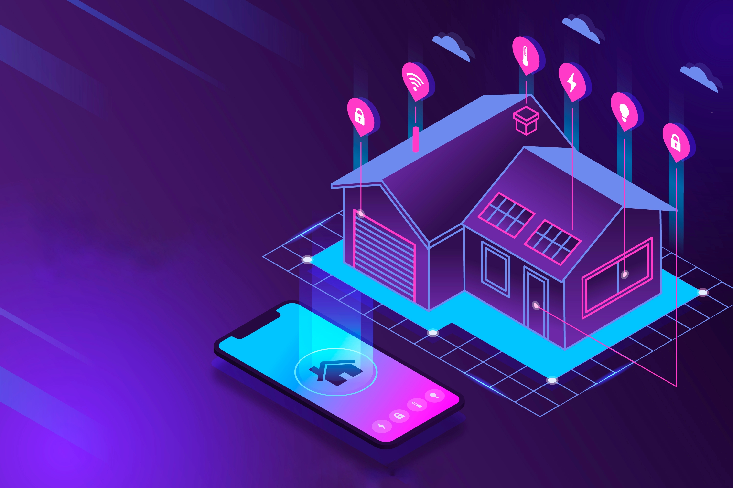
IOT BASED HOME AUTOMATION SYSTEM
"A technologically advanced living space where various devices and systems are connected and can be controlled remotely for increased convenience, comfort, and efficiency."
1

Slide 2
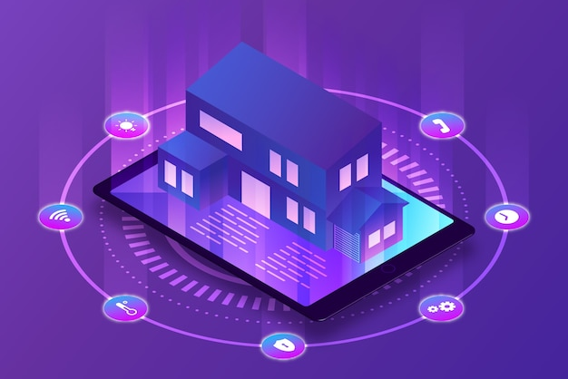
Content
1
2
Introduction
Principle & Operation
Circuit description
3
4
Pros & Cons
NodeMCU
IOT Light & Fan
Rain detector
Trace passing alarm
Bidirectional motor driver
Buzzer driver
Auto street light
Conclusion
5

Slide 3
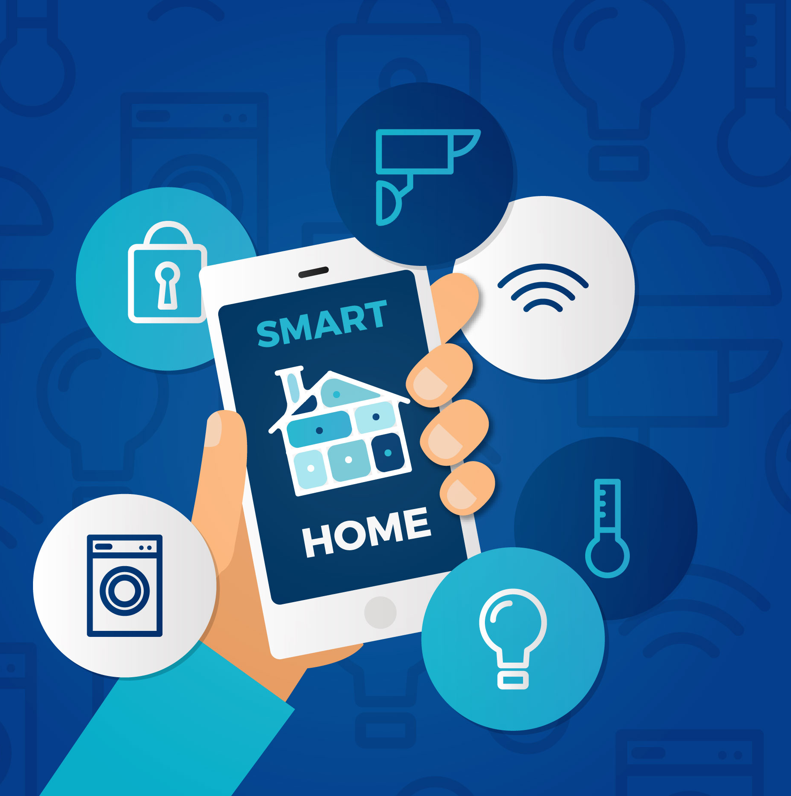
Introduction
A smart home revolutionizes the way we live by integrating intelligent technologies to automate and control various aspects of daily life for enhanced convenience and efficiency.

Slide 4
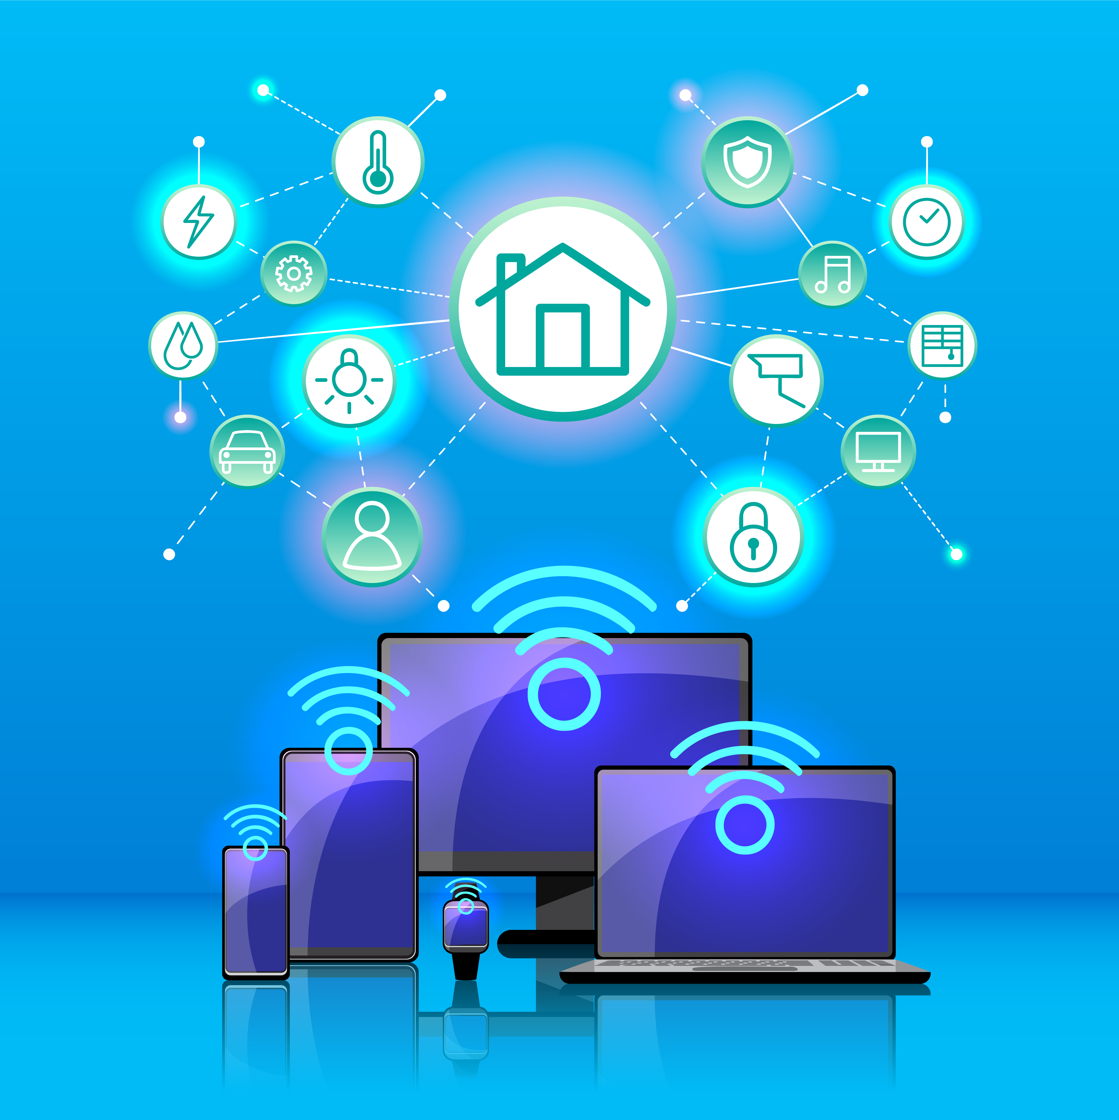
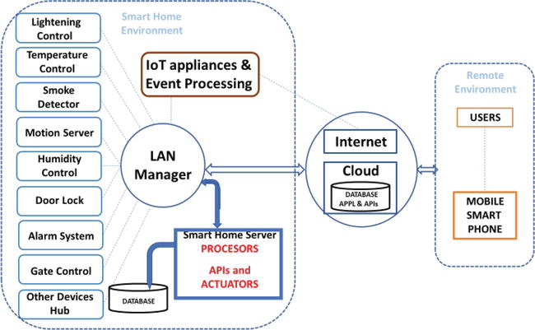
Principle & Operation

Slide 5
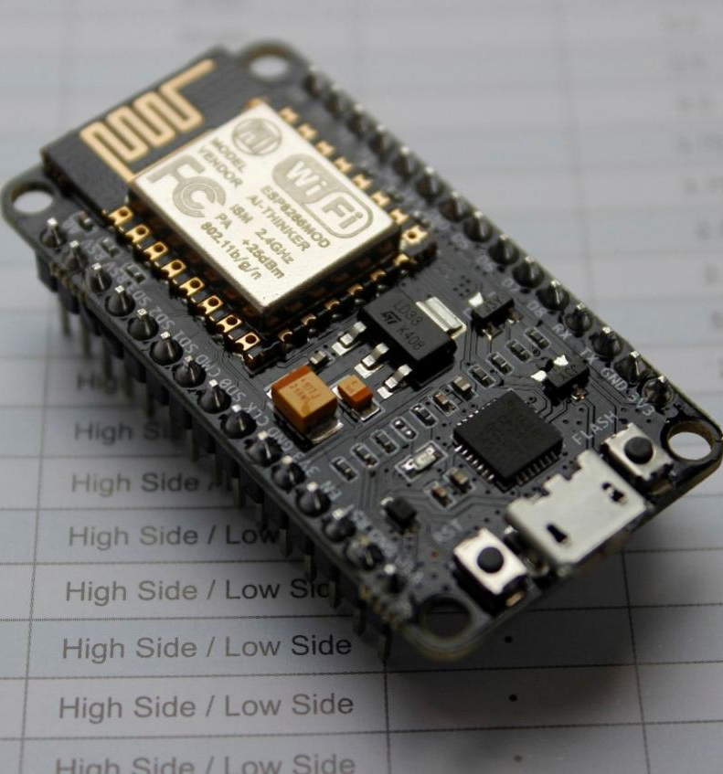
nodeMcu
ESP8266 Wi-Fi SoC from Espressif Systems.
32-Bit ESP32 MCU added.
12 GPIO Pins.

Slide 6
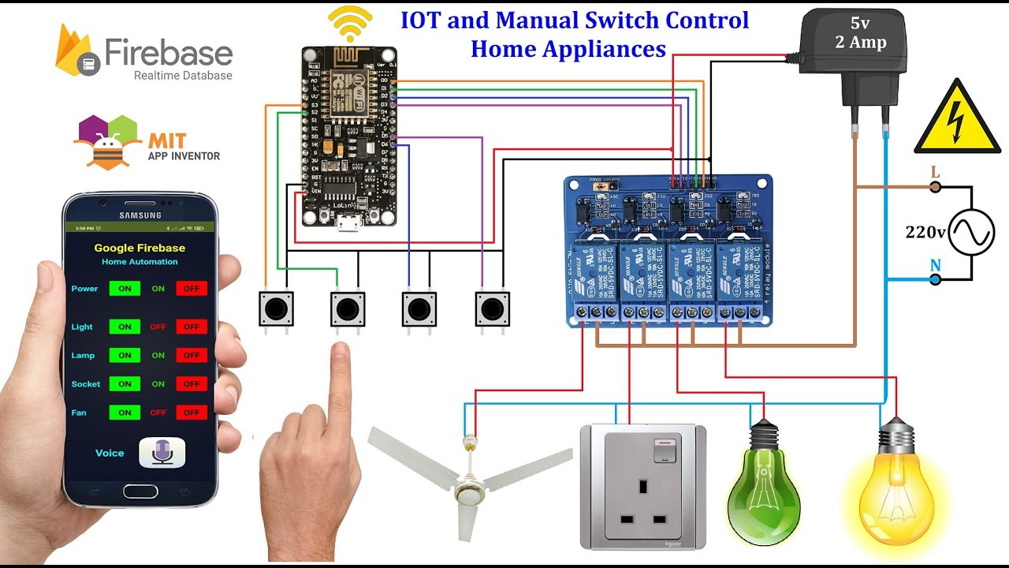
IOT Light & Fan

Slide 7
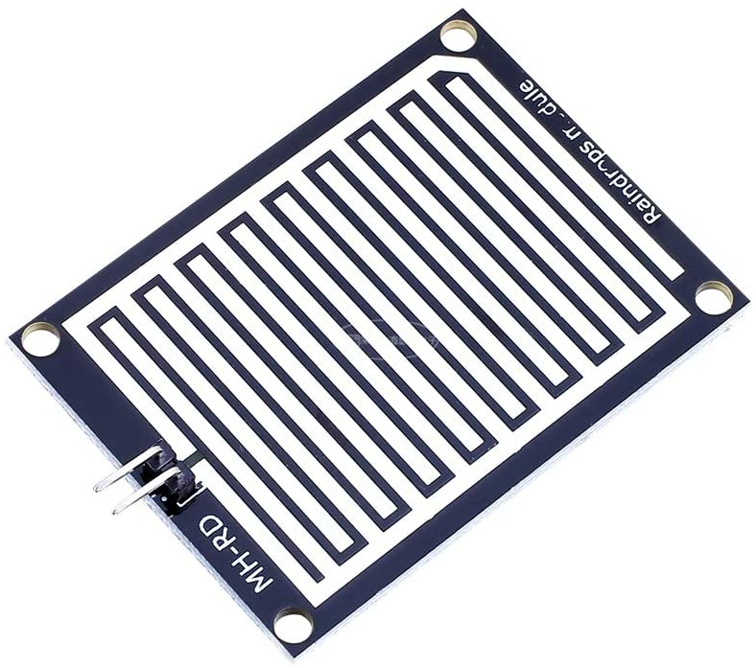
Rain Detector

Slide 8
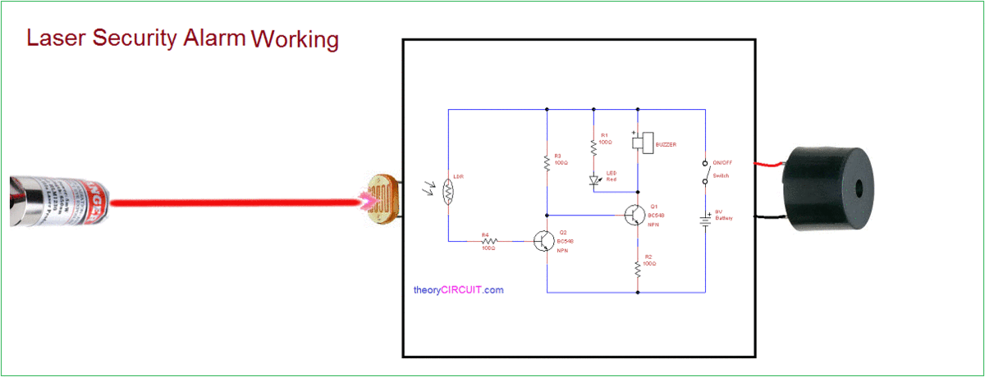
Trespassing Alarm

Slide 9
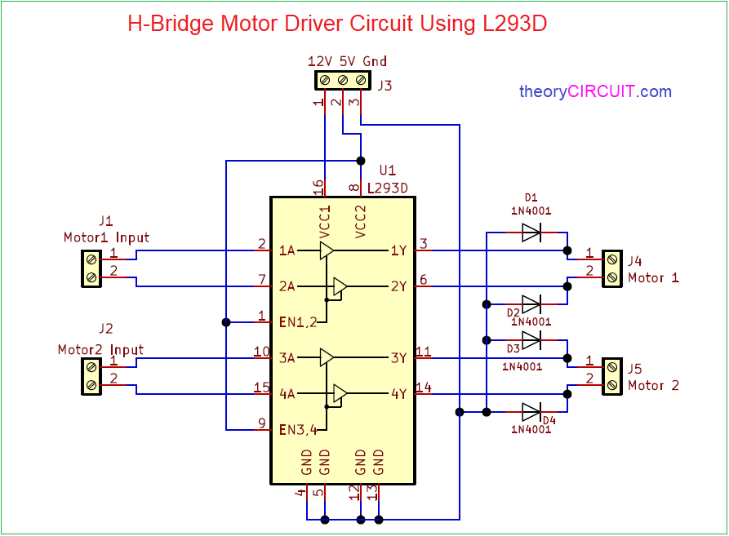
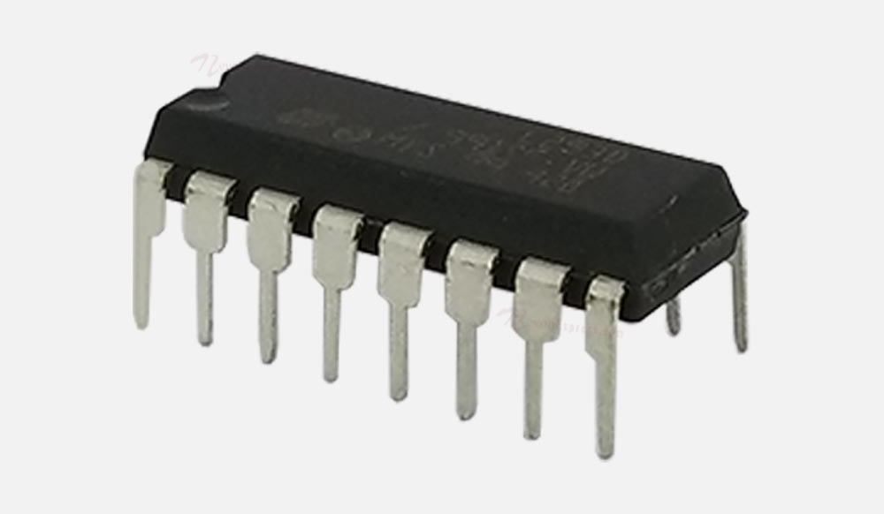
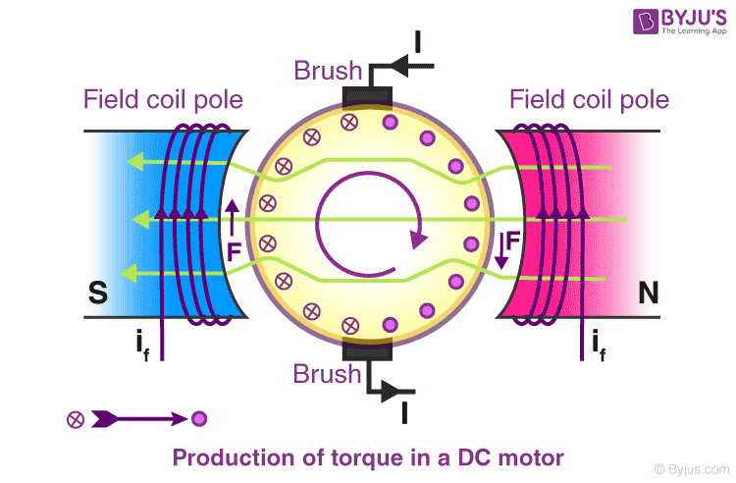
Bidirectional motor driver

Slide 10
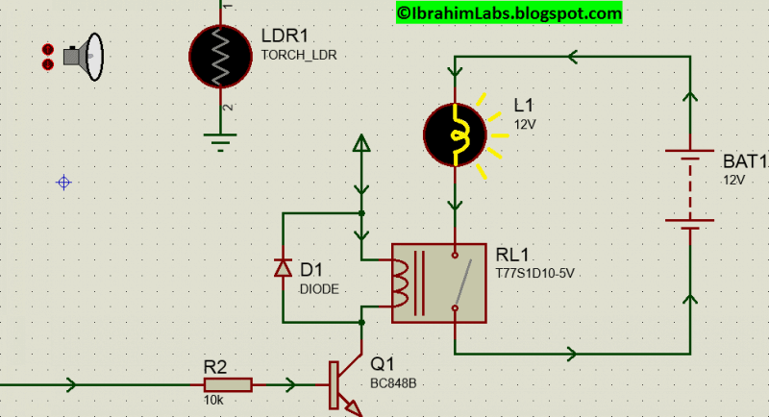
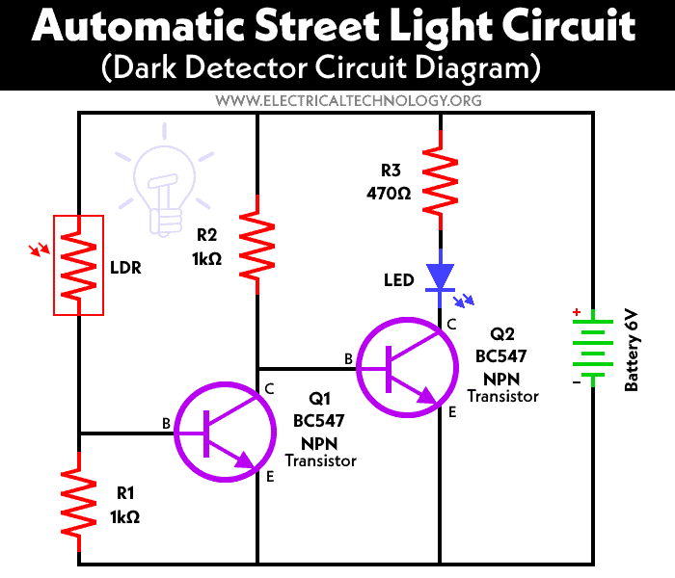
Automatic Street Light

Slide 11
Pros
Increased Security
Remote Monitoring, Surveillance & Real time Alerts.
Convenience, Comfort & Energy Efficient
Remote Control, Automation & Reduce utility bills.
Flexibility & Scalability
Add or Integrate new devices and functionalities.

Slide 12
Cons
High Cost
A significant upfront cost, Maintenance & Update.
Dependence on Connectivity
Can’t work without stable internet connection.
Technical Complexity
A layman can’t understand and troubleshoot the complexity.

Slide 13

Conclusion
Smart home automation offers unparalleled convenience, energy efficiency, and security, but careful consideration of costs, technical complexity, and privacy risks is essential for a successful implementation.

Slide 14




Meet our team
Subhadarshini baral
Khagapati nayak
Swikruti mishra
Ashutosh Mohapatra
21MET011
21MET003
21MET001
21MET009

Slide 15

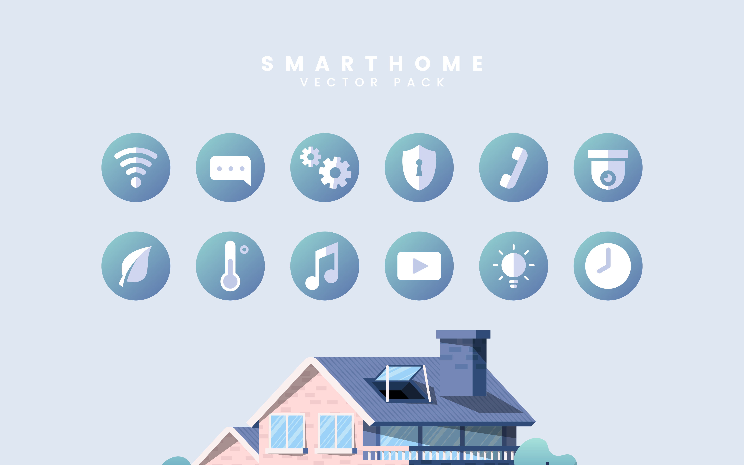
Any
Queries

Slide 16

Thank You

